Slide 1
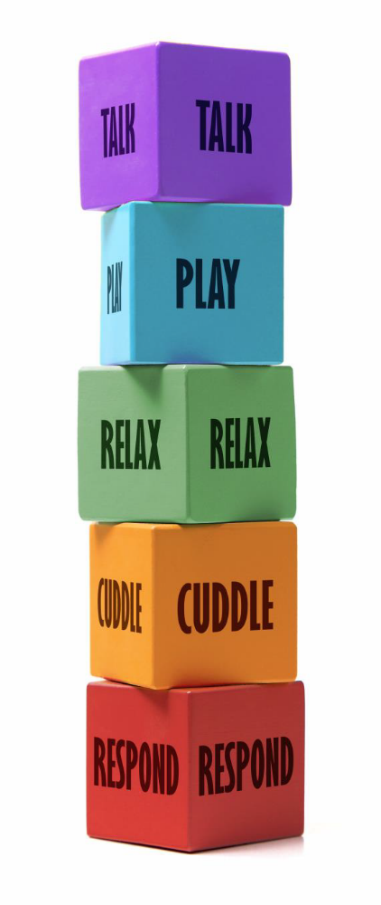

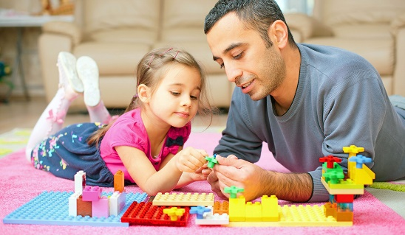

Play time
Talk--'I enjoy you playing alongside me talking about what we are doing.'
Play--'When we have some time together to play you make me feel special'.
Relax--'I like it when we have quiet times when playing.'
Cuddle/Engage--'When you sit close to me and share my ideas and thoughts I feel valued.'
Respond--'I like it when you listen to me talking and make me feel safe.'

