Slide 1
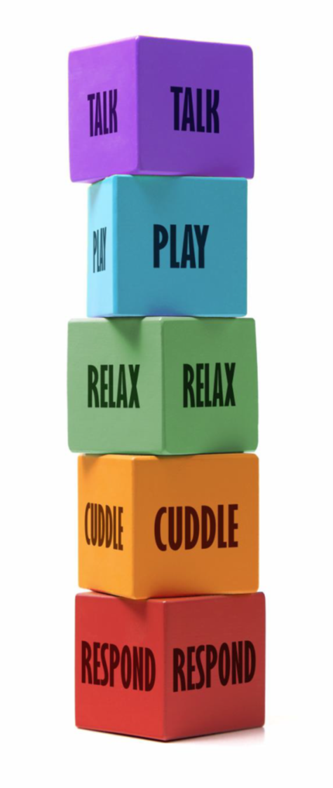
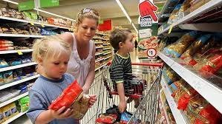

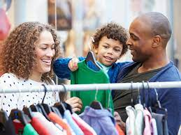
Going to the shops
Talk--'I like it when you explain what we are buying and why.
Play--‘I enjoy shopping when you make it fun—counting, sorting, helping you'.
Relax--'I like it when you give me time to look at things and we are not rushing.’
Cuddle/Engage--'When you stay close to me you make me feel safe.'
Respond--'I like it when you answer my questions and tell me more.'

